Slide 1

KKBOX EDA
Should I stay or should I go?
WSDM - KKBox’s Churn Prediction Challenge

Slide 2

Data
Individual feature visualization
Data set relations
Data cleaning
Multi-feature relation
OUTLINE
To predict whether a user of the music streaming service KKBox will churn

Slide 3





1.Data
Train.csv
Transaction.csv
User_logs.csv
Members.csv
Sample_submission_zero.csv
IDs
Churned or not
Payment method
Whether subscription was cancelled
Listening behavior
User age
User city
Test data set
the large size of the data → read part of data

Slide 4

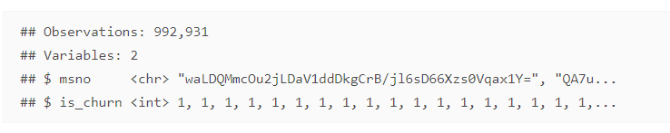
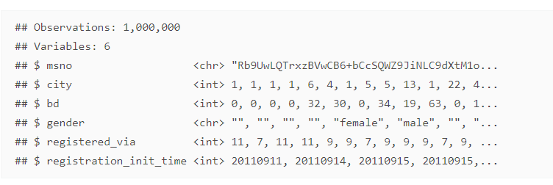
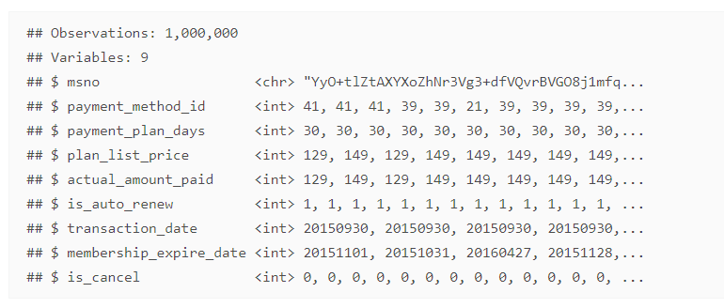
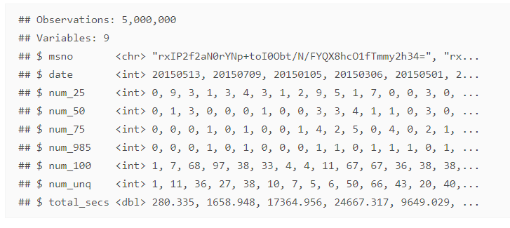
1.Data
Train data
File structure and content
Members.csv
Transaction.csv
No Nas
Few highly negative or positive values in total_sec
Reformating feature
User_logs.csv

Slide 5

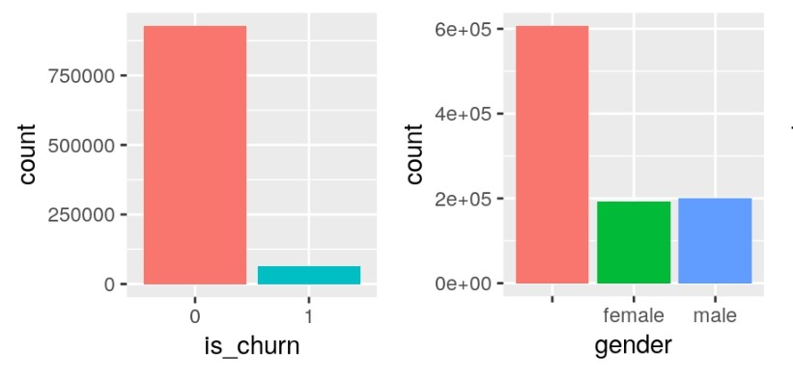
2.Individual feature visualization
Train and Members data
Only about 6% of users seemed to have left.
The clear majority of users did not provide information on their gender.

Slide 6

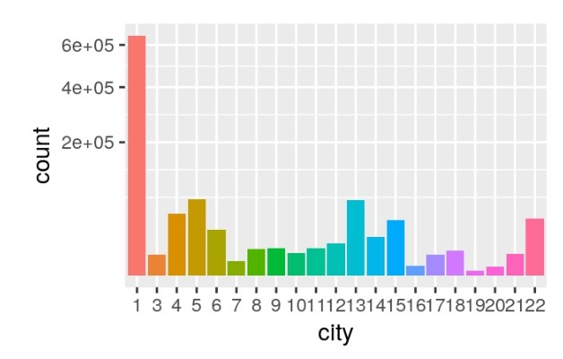


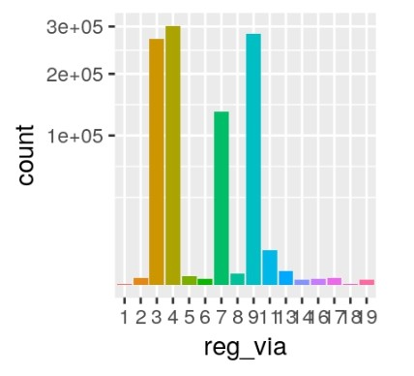
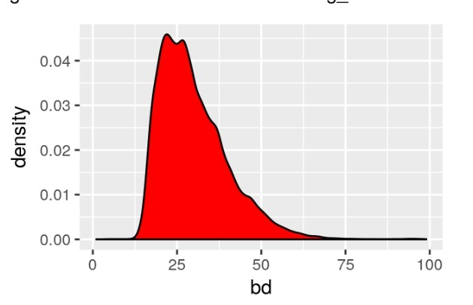
2.Individual feature visualization
Train and Members data

Slide 7
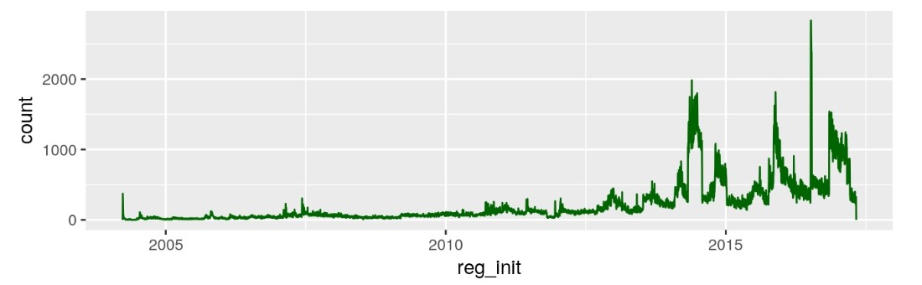
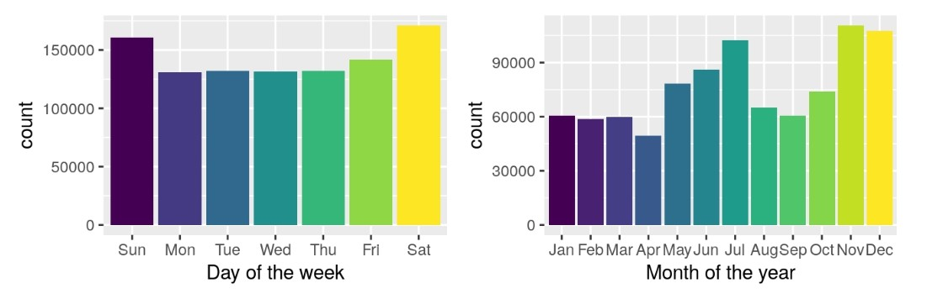
2.Individual feature visualization
Train and Members data

Slide 8

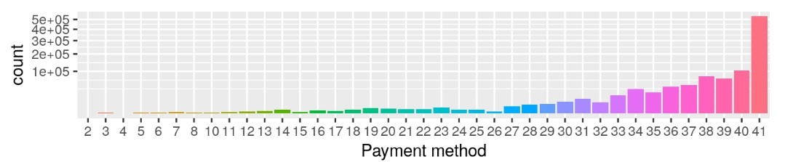
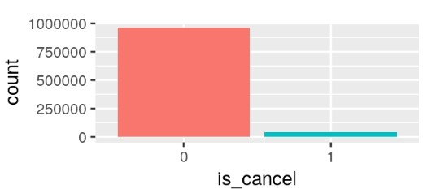
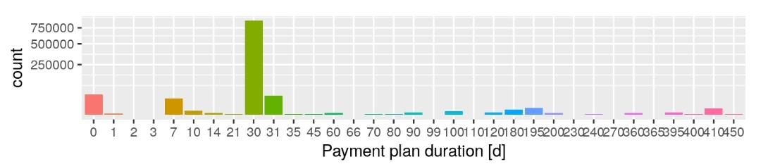
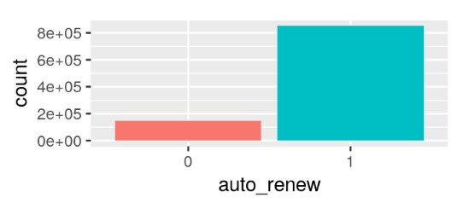
2.Individual feature visualization
Transection data set

Slide 9

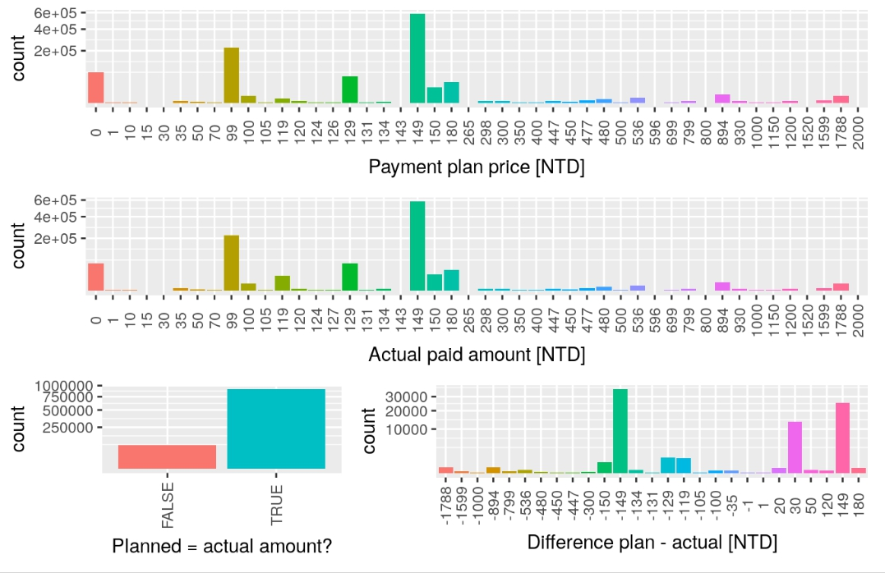
2.Individual feature visualization
Transection data set
there are differences in the planned vs actual payment for individual users.
In most of these cases the users ended up paying more

Slide 10

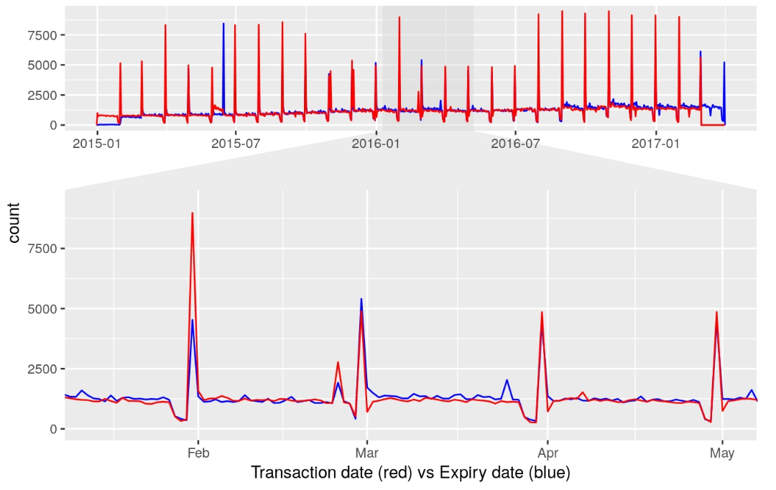
2.Individual feature visualization
Transection data set
Both features share a very similar time series.
This might be due to the (automatic) renewals of the user subscriptions.

Slide 11

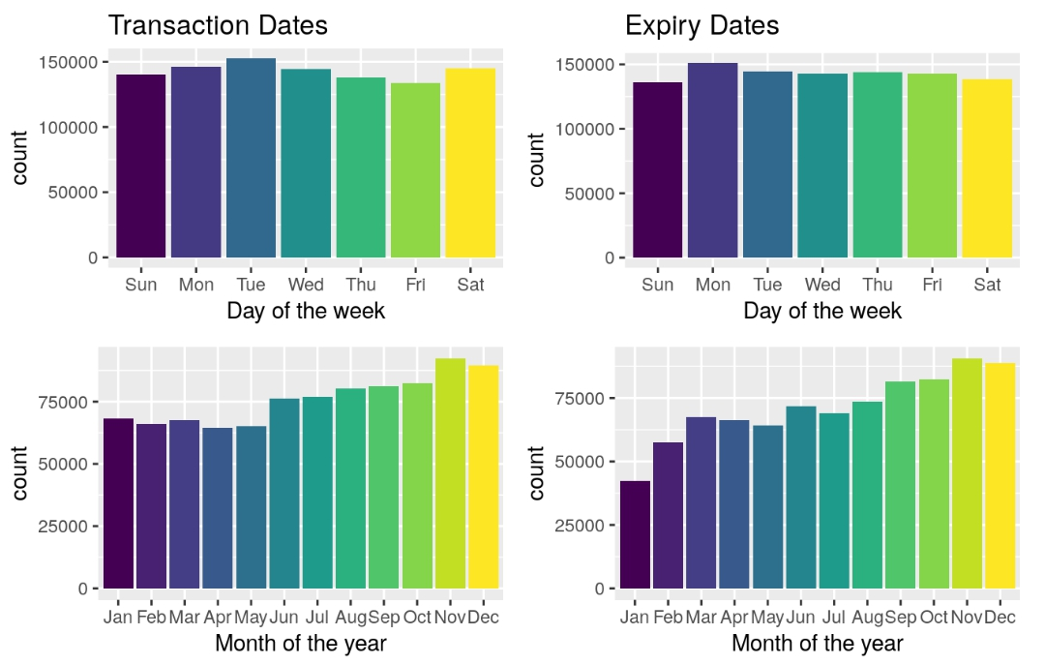
2.Individual feature visualization
Transection data set
In our relatively limited data set such a difference might be caused by a larger number of spikes falling on one of these days.
Behavior is consistent with a positive linear trend.

Slide 12

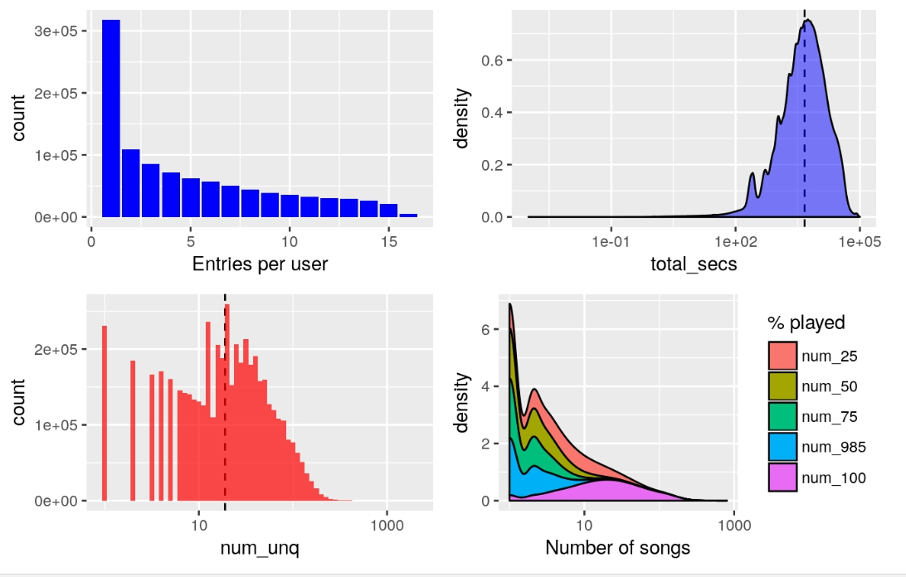
2.Individual feature visualization
User Logs
The original file takes up about 27 GB in uncompressed form
→only use the first 1% of this data (still 20 million rows).
1~16 days
1.3 hr
roughly log-normal distributed

Slide 13

19
2.Individual feature visualization
User Logs
The distribution of number of songs played, shown as a stacked density plot for the different percentages of song completion shows notable differences between the groups.

Slide 14

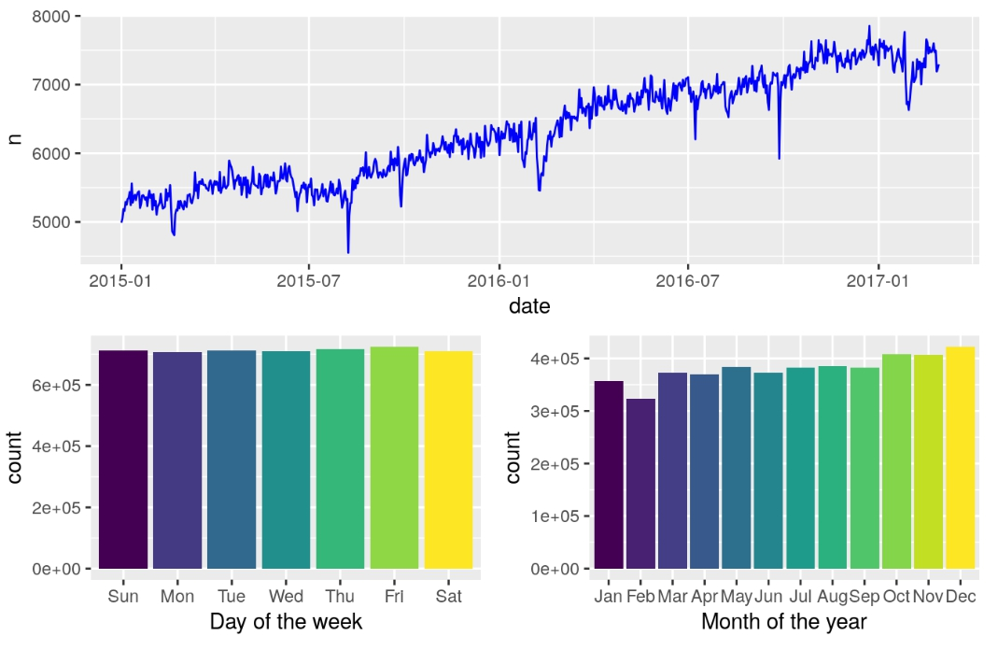
2.Individual feature visualization
The number of logs over time rises steadily with only occasional short-term fluctuations.
For the monthly plot we did not include the first two months of 2017; leaving only the data of the complete years 2015 and 2016.
User Logs

Slide 15
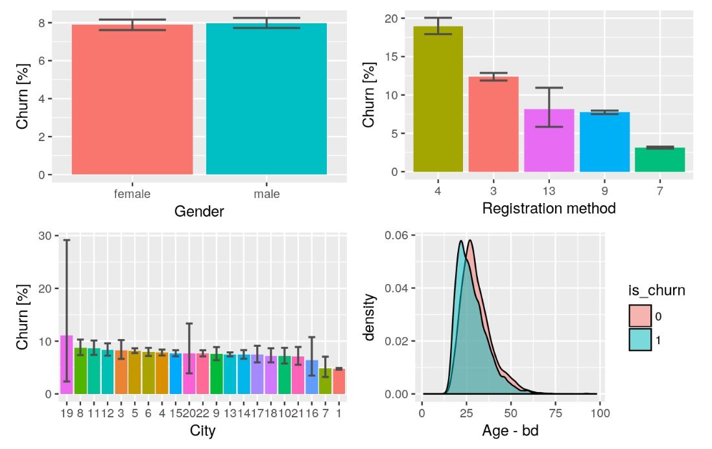
3.Data set relations with churn rate
many users leave
Members data set
most loyal users
younger users are
more likely to churn
6%~12%
< 5% , the most popular city
a big impact on the overall churn rate of about 6.4%.

Slide 16

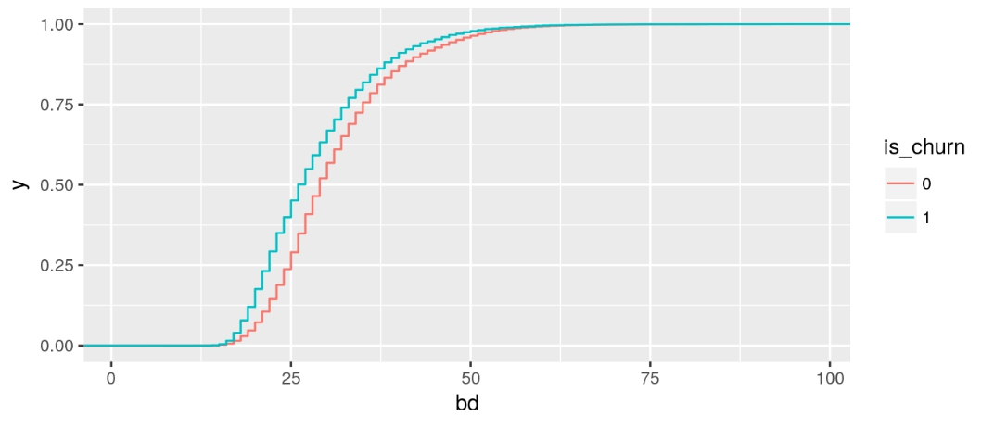
3.Data set relations with churn rate
Members data set
Wilcox test : significantly different

Slide 17
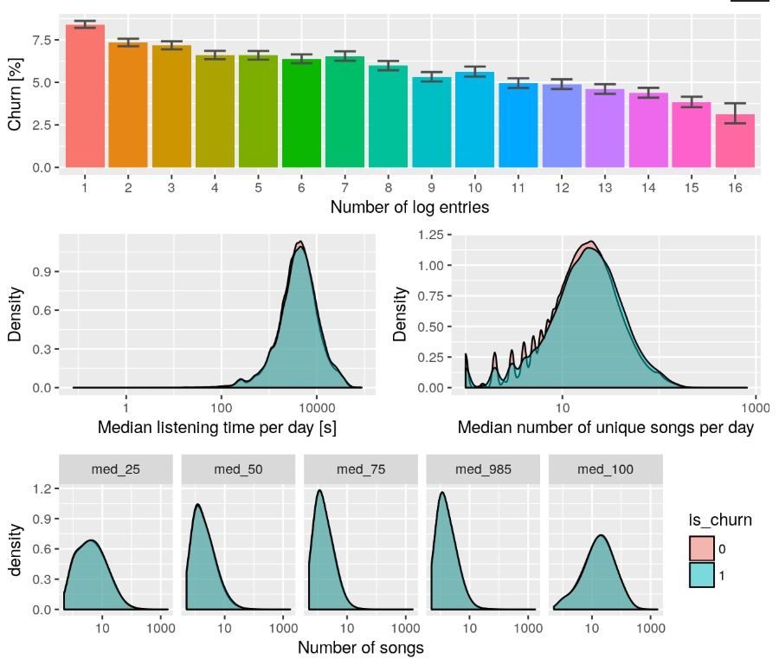
3.Data set relations with churn rate
User logs data set
A random sub-sample of 5% (1e5 observations) of our user_logs sample to speed up the processing
The fewer log data entries a user has the more likely they are to churn.

Slide 18
3.Data set relations with churn rate
User logs data set
The distributions of median listening times for users who churned vs not churned are practically indistinguishable.
The median number of unique songs per user per day looks very similar for both samples, with a slight preference of fewer song per day for users who ended up churning.

Slide 19
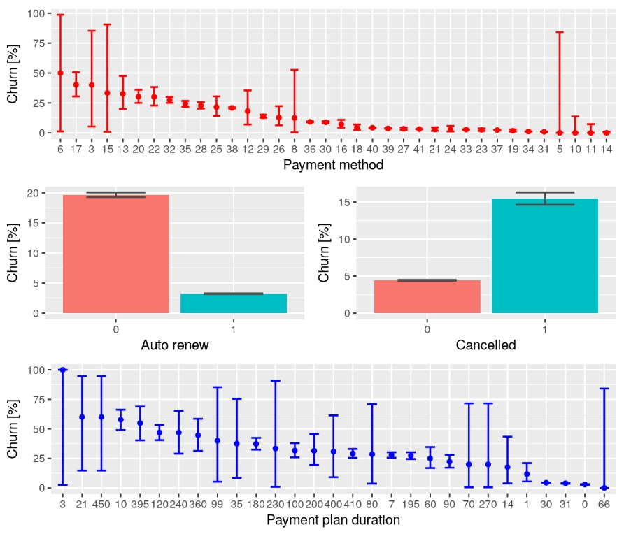
3.Data set relations with churn rate
Transactions data set
Some payment method are associated to more loyal users
The vastly popular payment method

Slide 20

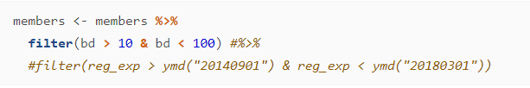
4.Data cleaning
Remove the obvious outliers before analyzing data
e.g. negative ages or the very early expiration date

Slide 21
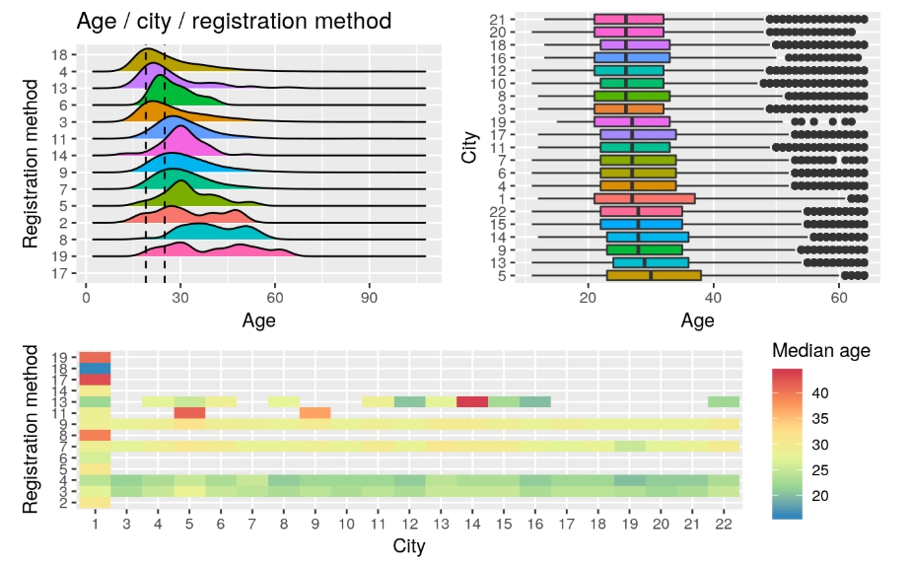
5.Multi-feature relations
Younger users
Given the strong dependence of the churn rate on reg_via, this age distribution might be the reason.
Peak 25
The age distributions for the different cities are very similar.

Slide 22
5.Multi-feature relations
We also notice that through the cleaning we have lost methods “10” and “16” which seemed to have mainly produced older or spurious entries.
Purely random

Slide 23
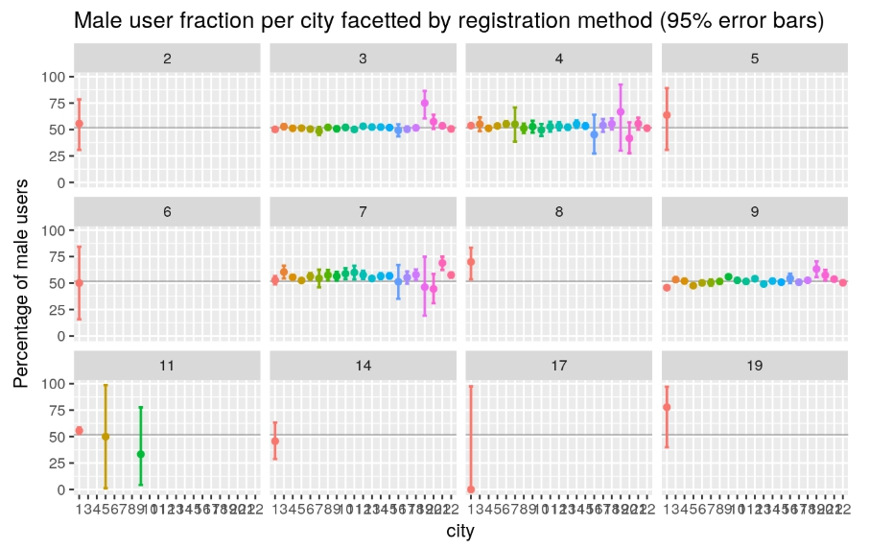
5.Multi-feature relations

Slide 24
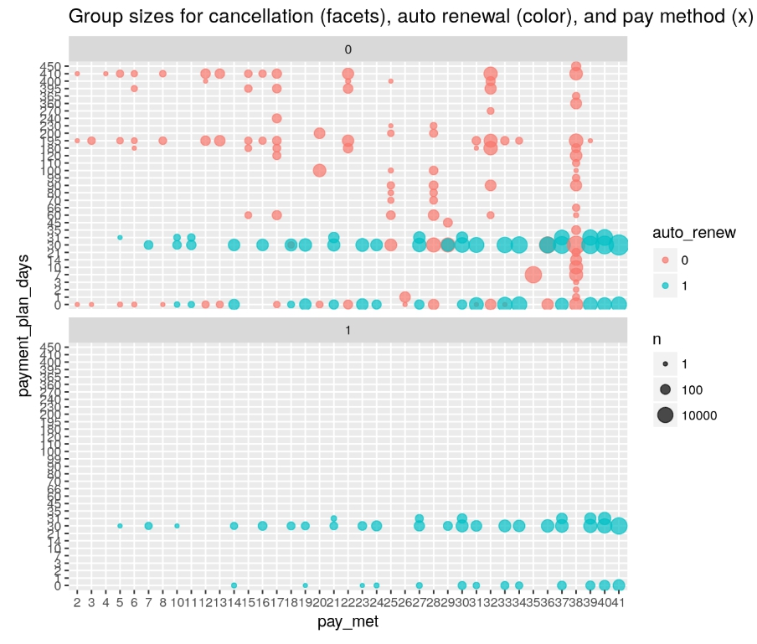
5.Multi-feature relations
small fraction of combinations between payment_method_id & payment_plan_days
→ large empty graph
Cancellations only came from users that had auto renewal activated

Slide 25

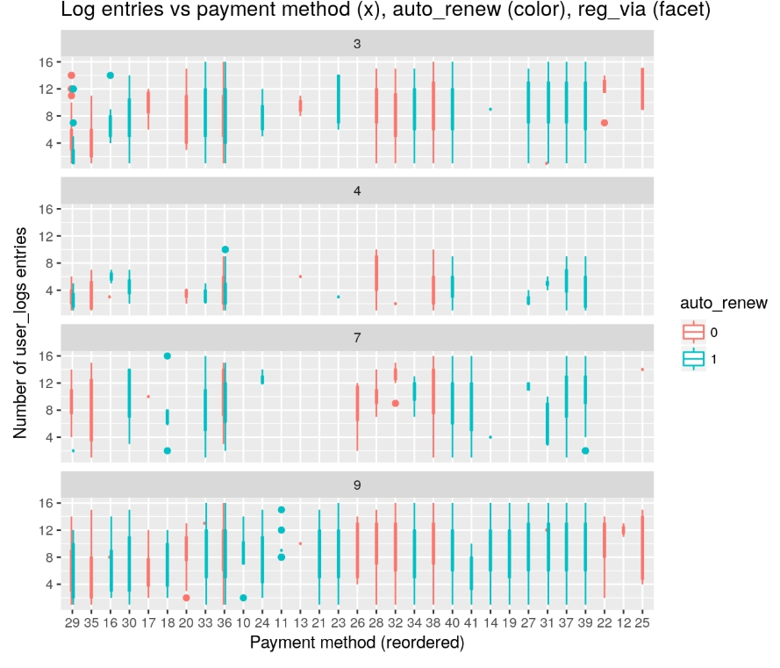
5.Multi-feature relations
Registration method “4” has significantly lower counts .
The payment methods show significant differences in count frequency among themselves and also for different registration methods.

Slide 26
THANKS FOR LISTENING

